Slide 1

Competitive Algorithm Calculation Testing in a Unified System
(C.A.C.T.U.S.)
Preliminary Design
Presented By:
ExoNET Solutions
12/7/2011

Slide 2
Welcome
Dr. Darren Lim
Associate Professor of Computer Science
Siena College

Slide 3
Agenda
Introductions
Problem Overview
Project Status
User Case Narratives
UML Diagrams
Website Map
Data Flow Diagrams
Requirements Inventory
Testing
Data Dictionary
Prototype Screens
Timeline
What is next for ExoNET?

Slide 4
ExoNET Solutions
Team Members
David Purcell
Team Leader
Stephanie Del Belso
Documents Analyst
Thomas Delaney
Systems Administrator
Marco Samaritoni
Web Master
Paul Amodeo
Assistant Web Master

Slide 5
Agenda
Introductions
Problem Overview
Project Status
User Case Narratives
UML Diagrams
Website Map
Data Flow Diagrams
Requirements Inventory
Testing
Data Dictionary
Prototype Screens
Timeline
What is next for ExoNET?

Slide 6
Problem Overview
Current contest system is loosely structured
Inconvenient for judges and contestants
Not easily maintained
Not fully automated

Slide 7
Agenda
Introductions
Problem Overview
Project Status
User Case Narratives
UML Diagrams
Website Map
Data Flow Diagrams
Requirements Inventory
Testing
Data Dictionary
Prototype Screens
Timeline
What is next for ExoNET?

Slide 8
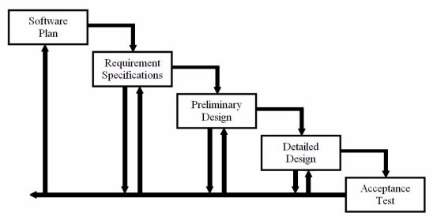
Project Status
Development
and
Testing
Preliminary
Design

Slide 9
Agenda
Introductions
Problem Overview
Project Status
User Case Narratives
UML Diagrams
Website Map
Data Flow Diagrams
Requirements Inventory
Testing
Data Dictionary
Prototype Screens
Timeline
What is next for ExoNET?

Slide 10
User Case Narratives
Describe the behavior of users within a system.
Aid in the discovery of requirements
No updates made from Requirements Specification

Slide 11
User Case Narratives
All users can securely log in and log out of C.A.C.T.U.S.
Contestants can submit contest submissions
System Administrator can configure all contest settings
Judges are given teams to supervise
Users can interact with each other by using the chat window

Slide 12
Agenda
Introductions
Problem Overview
Project Status
User Case Narratives
UML Diagrams
Website Map
Data Flow Diagrams
Requirements Inventory
Testing
Data Dictionary
Prototype Screens
Timeline
What is next for ExoNET?

Slide 13
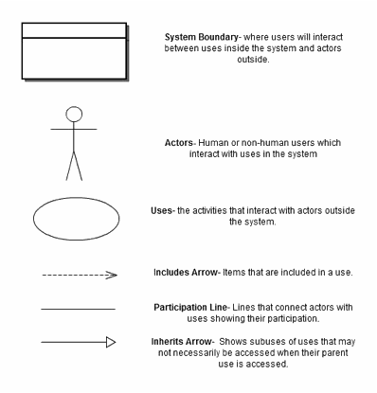
UML Use Case Diagram Legend

Slide 14
UML Use Case Diagram: C.A.C.T.U.S.

Slide 15
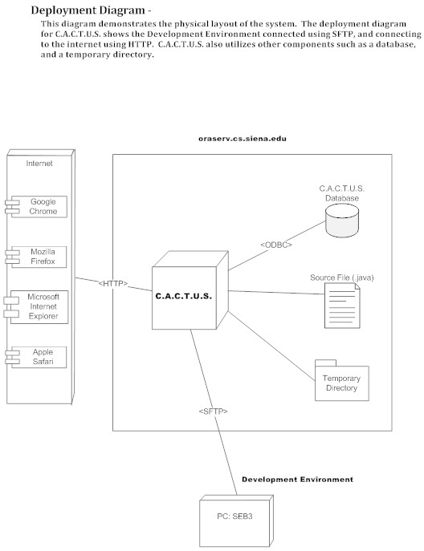
UML Deployment Diagram

Slide 16
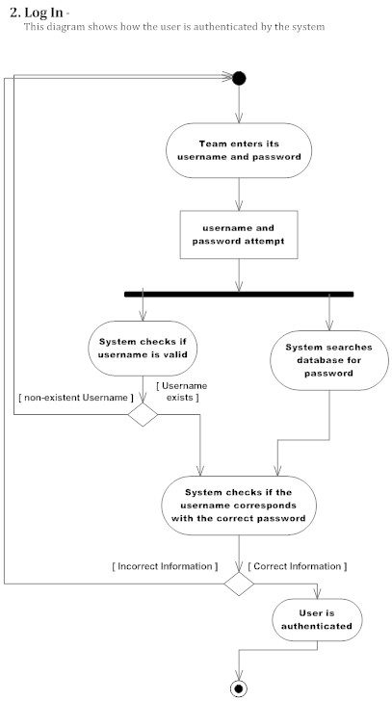
UML Activity Diagram
Activity Diagrams are graphical representations of workflows of stepwise activities and actions of components in a system.

Slide 17
Agenda
Introductions
Problem Overview
Project Status
User Case Narratives
UML Diagrams
Website Map
Data Flow Diagrams
Requirements Inventory
Testing
Data Dictionary
Prototype Screens
Timeline
What is next for ExoNET?

Slide 18
Website Map
Displays an overview of the structure of a website
Map Key:

Slide 19
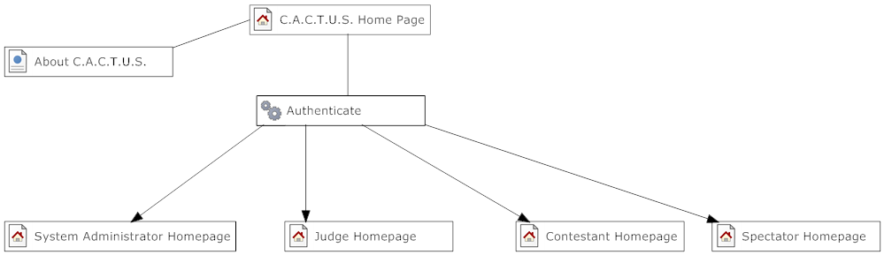
C.A.C.T.U.S Homepage

Slide 20
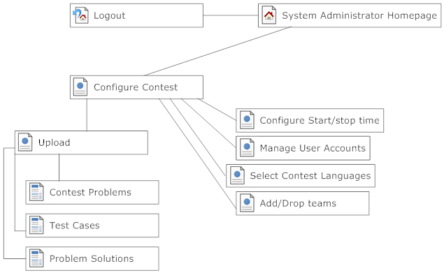
System Administrator Homepage

Slide 21
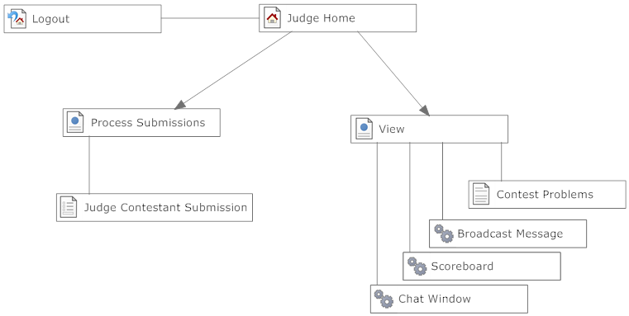
Judge Homepage

Slide 22
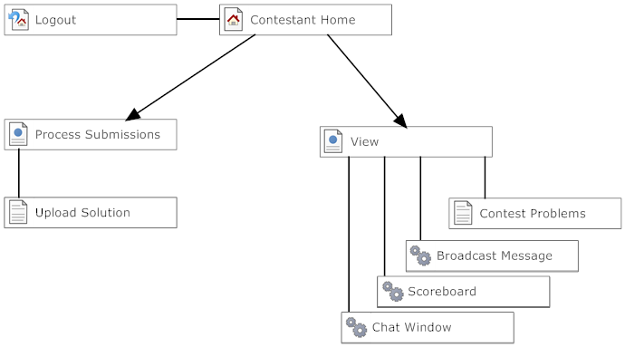
Contestant Homepage

Slide 23
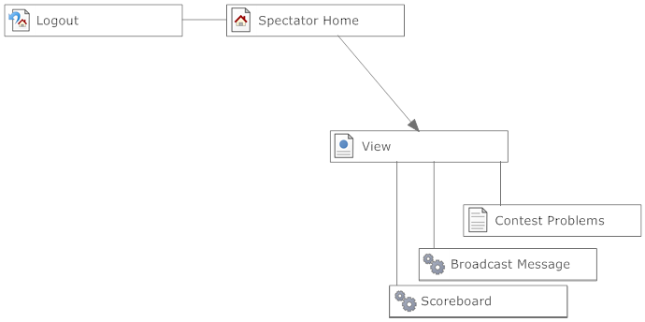
Spectator Homepage

Slide 24
Agenda
Introductions
Problem Overview
Project Status
User Case Narratives
UML Diagrams
Website Map
Data Flow Diagrams
Requirements Inventory
Testing
Data Dictionary
Prototype Screens
Timeline
What is next for ExoNET?

Slide 25
Data Flow Diagrams
Visual representation of data flow
Context Diagram – Highest level of abstraction and external users
Level 0 Diagram – Major processes and data
Level 1-3 Diagrams – More detailed view of a process

Slide 26
Data Flow Diagrams Legend
Data Source/Sink
Process
Data Flow
Data Store

Slide 27
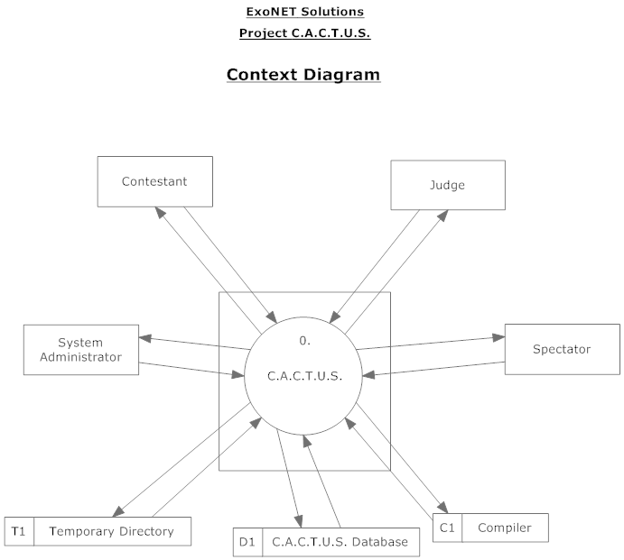
Data Flow Diagram:
Context Diagram

Slide 28
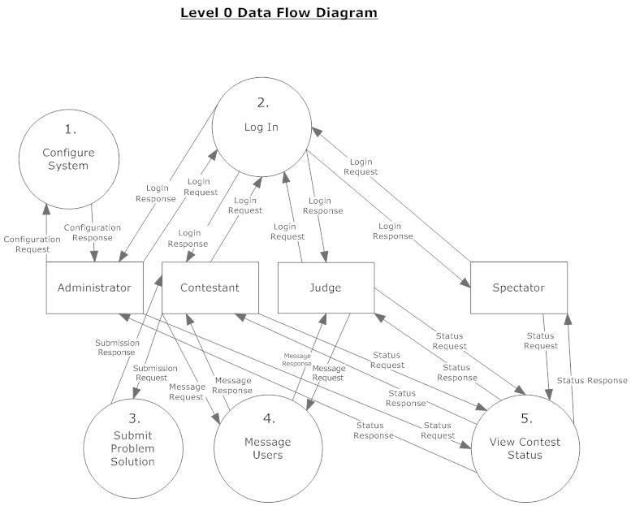
Data Flow Diagram: Level 0 Diagram

Slide 29
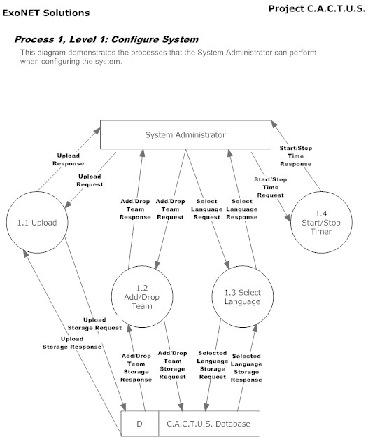
Data Flow Diagram: Level 1

Slide 30
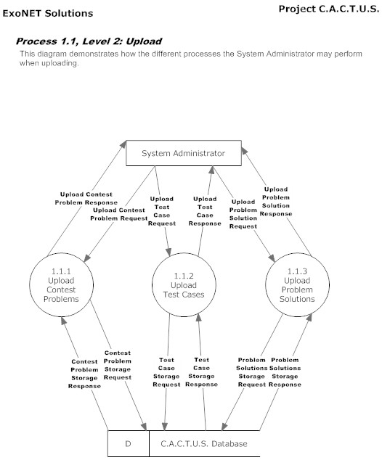
Data Flow Diagram: Level 2

Slide 31
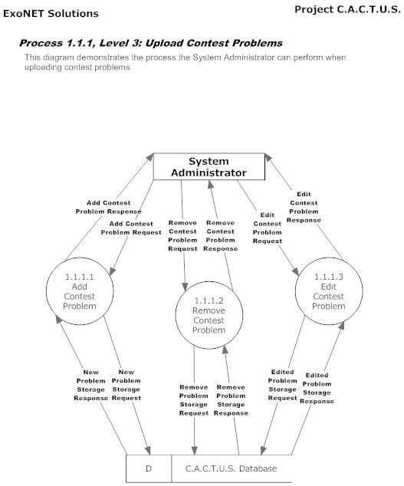
Data Flow Diagram: Level 3

Slide 32
Agenda
Introductions
Problem Overview
Project Status
User Case Narratives
UML Diagrams
Website Map
Data Flow Diagrams
Requirements Inventory
Testing
Data Dictionary
Prototype Screens
Timeline
What is next for ExoNET?

Slide 33
Requirements Inventory:
C.A.C.T.U.S.
Responsive
Scalable
Robust
Usable in multiple Web Browsers
Run programming contests
Compile programs during the contest

Slide 34
Agenda
Introductions
Problem Overview
Project Status
User Case Narratives
UML Diagrams
Website Map
Data Flow Diagrams
Requirements Inventory
Testing
Data Dictionary
Prototype Screens
Timeline
What is next for ExoNET?

Slide 35
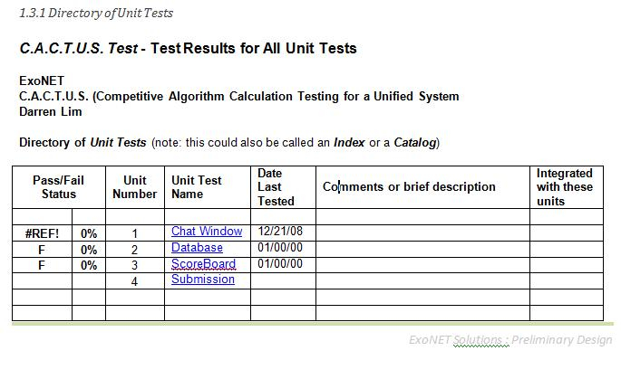
Testing Units

Slide 36
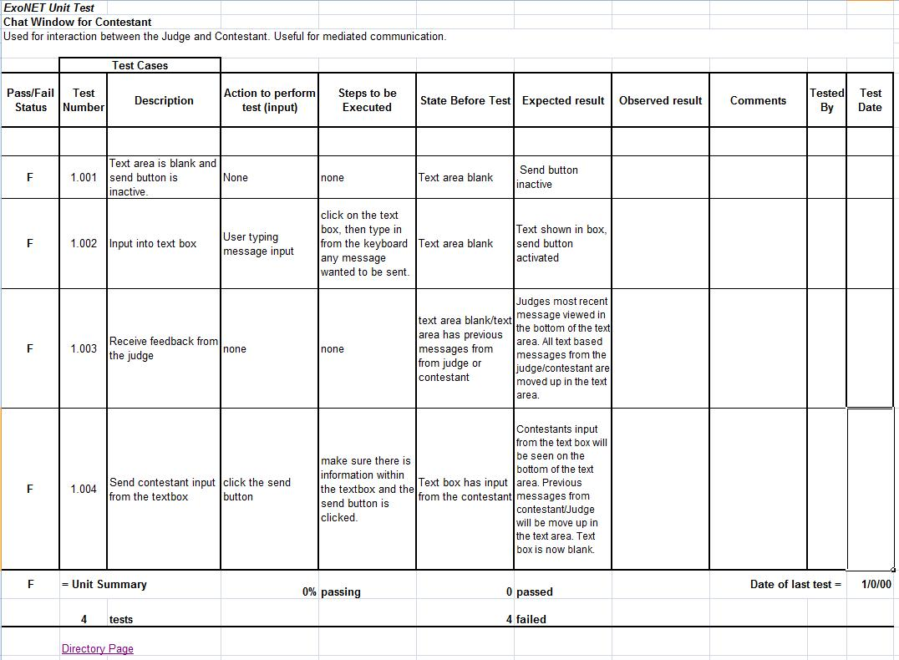
Chat Window Unit Test

Slide 37
Agenda
Introductions
Problem Overview
Project Status
User Case Narratives
UML Diagrams
Website Map
Data Flow Diagrams
Requirements Inventory
Testing
Data Dictionary
Prototype Screens
Timeline
What is next for ExoNET?

Slide 38
Logical Data Dictionary
Stores information about the data types used in our software.
Stores types of data entities
Explanations regarding how these entities will be used.

Slide 39
Agenda
Introductions
Problem Overview
Project Status
User Case Narratives
UML Diagrams
Website Map
Data Flow Diagrams
Requirements Inventory
Testing
Data Dictionary
Prototype Screens
Timeline
What is next for ExoNET?

Slide 40
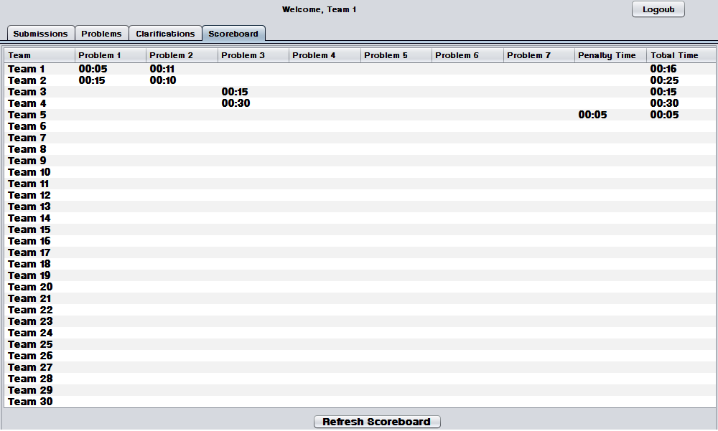
Prototype-Scoreboard

Slide 41
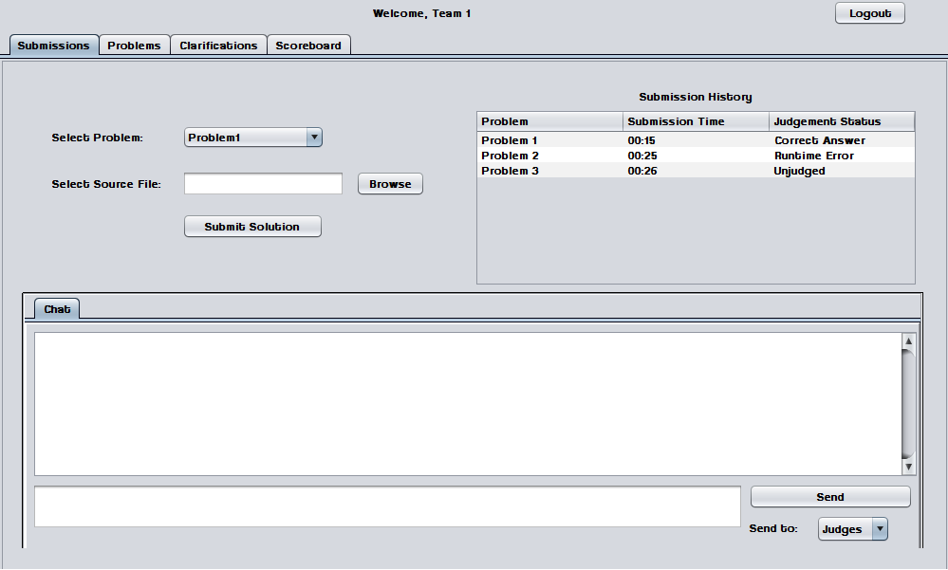
Prototype-Contestant Submission Tab View

Slide 42
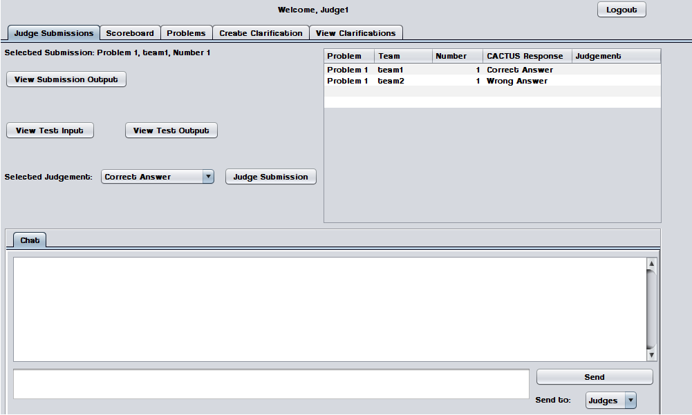
Prototype-Judge View Submissions Tab

Slide 43
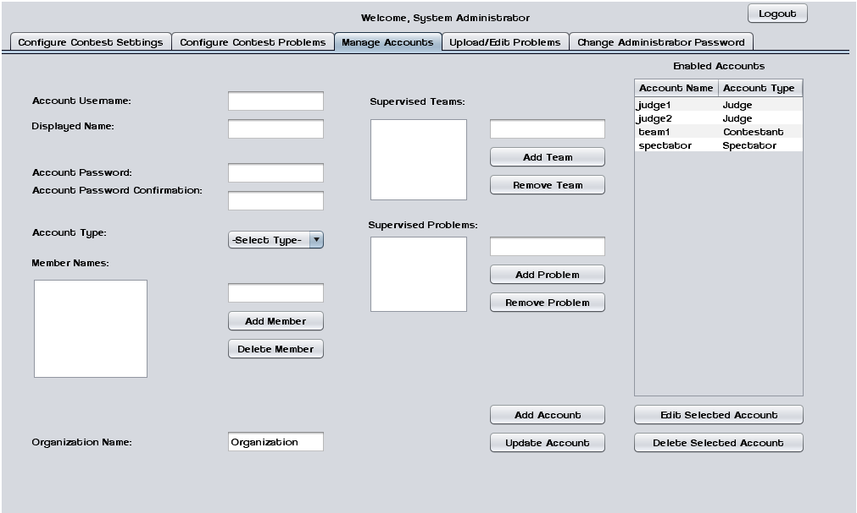
Prototype-System Administrator Manage Accounts Tab View

Slide 44
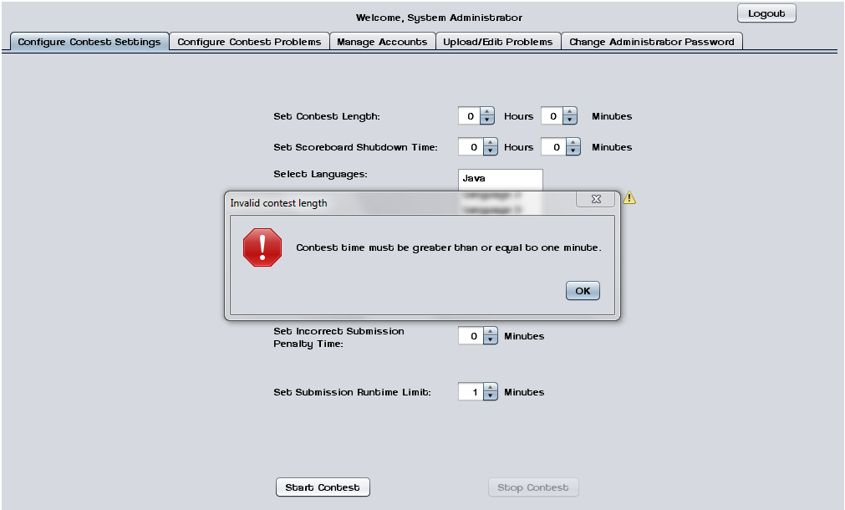
Prototype-System Administrator Configure Contest Settings Tab View (Error Message)

Slide 45
Agenda
Introductions
Problem Overview
Project Status
User Case Narratives
UML Diagrams
Website Map
Data Flow Diagrams
Requirements Inventory
Testing
Data Dictionary
Prototype Screens
Timeline
What is next for ExoNET?

Slide 46
Timeline

Slide 47
Agenda
Introductions
Problem Overview
Project Status
User Case Narratives
UML Diagrams
Website Map
Data Flow Diagrams
Requirements Inventory
Testing
Data Dictionary
Prototype Screens
Timeline
What is next for ExoNET?

Slide 48
What is next for ExoNET?
Detailed Design Delivered – March 6th, 2012
Detailed Design Presentation – March 7th, 2012
Acceptance Test Delivered – April 23rd, 2012
Acceptance Test Presentation – April 24th, 2012

Slide 49

Thank You.
Questions? Comments?

